Slide 1
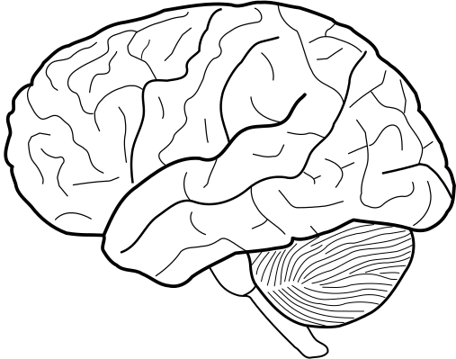
TOWARD TRUSTWORTHY CLINICAL DECISION
SUPPORT
Robust and Explainable Machine Learning for Stroke Risk Stratification

Slide 2
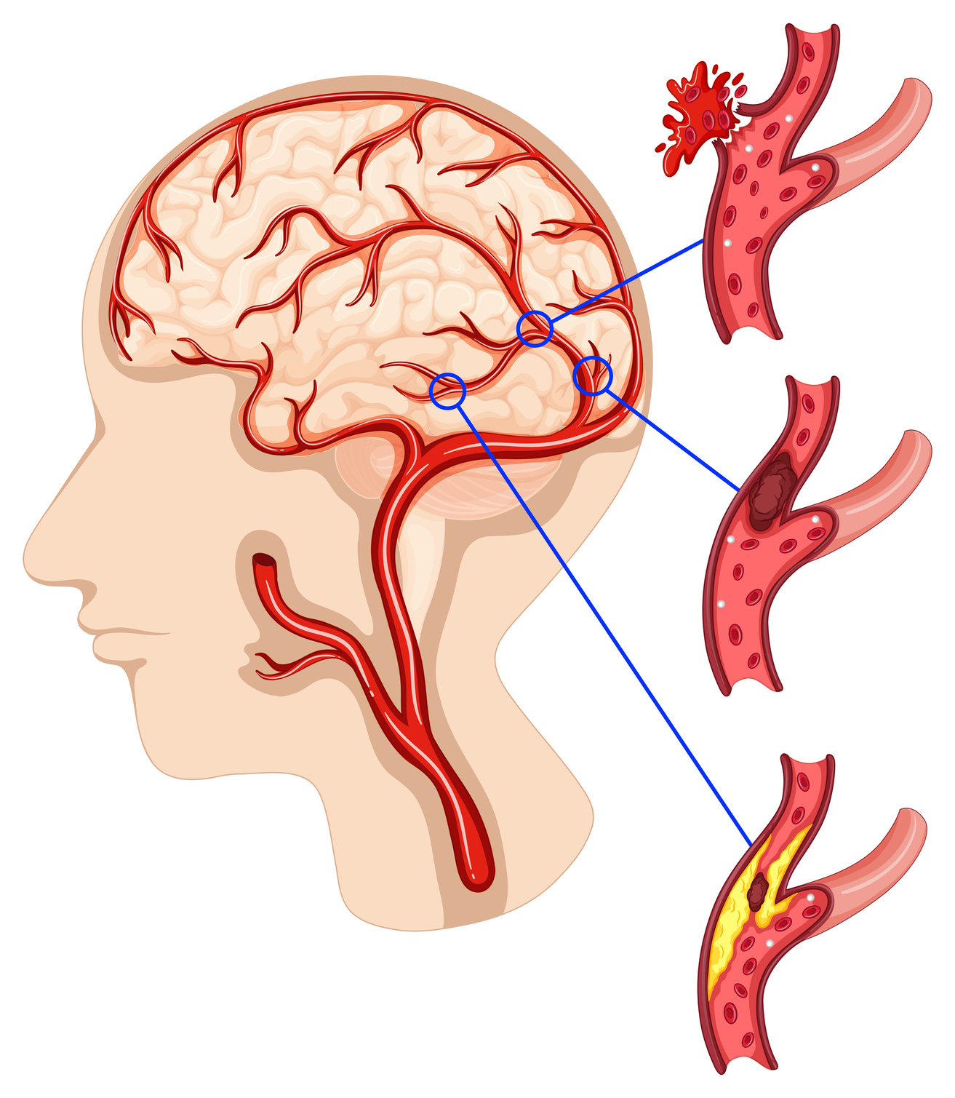
PRESENTER
ANTOR CHANDRA DAS
21-45849-3
SUPERVISOR
PROF.DR.ASRAF ALI

Slide 3

CONTENT
01
Problem Background
02
Motivation
03
Objective
04
Methodology
05
Results
06
Main Contribution
07
Conclusion
08
Reference

Slide 4
PROBLEM BACKGROUND
01
Stroke is a global health threat
As a top cause of death, stroke requires proactive prediction, not just reactive diagnosis. Existing predictive models fail because they struggle with imbalanced data and are too opaque for clinical trust. This limits our ability to identify and help at-risk patients before a stroke occurs.
It is the second leading cause of death and long-term disability worldwide.
02
Prediction is better than reaction
MRI and CT confirm stroke only after it occurs, but early prediction can save lives.
03
Need for decision support
Clinicians require tools that can assess stroke risk early and accurately.

Slide 5
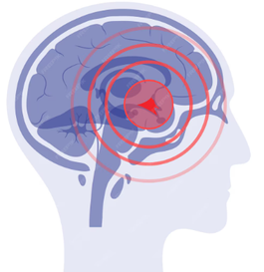



MOTIVATION
Class imbalance issue
Stroke is rare in population datasets, making prediction difficult without careful data balancing.
Lack of trust in black-box models
Stroke prediction is difficult because clinical datasets are often imbalanced and high-performing models are usually black boxes that clinicians cannot fully trust. Moreover, many studies use only simple preprocessing, failing to handle missing or noisy data effectively. These limitations motivate the development of a robust and interpretable machine learning framework that ensures both accuracy and transparency for real clinical use.
Clinicians hesitate to adopt ML systems that cannot explain their predictions.
Weak feature engineering in prior work
Many studies fail to robustly handle missing, noisy, or redundant data.
Our motivation
To design a trustworthy ML framework that bridges research models with clinical adoption.

Slide 6




OBJECTIVES
Develop a robust ML model
Systematic class imbalance handling
Interpretability with SHAP
Enable preventive care
Build an accurate stroke prediction system using structured patient data.
Test multiple balancing methods instead of relying on a single default approach.
Provide global and patient-specific explanations of risk predictions.
Help clinicians identify at-risk patients earlier to prevent severe outcomes.

Slide 7
METHODOLOGY
(PHASED APPROACH)
Preprocessing
Balancing
We utilized the public Kaggle Stroke Dataset of 5,110 patient records. To ensure data quality, missing BMI values were imputed using MICE. All categorical features were one-hot encoded and numerical features were standardized for model compatibility.
The dataset's severe class imbalance (~5% stroke cases) was systematically addressed. We compared four techniques: SMOTE, ADASYN, Tomek Links, and Cost-Sensitive learning. The goal was to find the method that best improved the model's ability to detect the rare stroke class.
Model Training
Interpretability
Four classical ML models (Logistic Regression, SVM, KNN, Random Forest) were trained on the optimally balanced data. We focused evaluation on metrics sensitive to imbalance, primarily Recall and F1-Score. This ensures we measure true clinical utility, not just overall accuracy.
To make the high-performing "black-box" model transparent, we employed the SHAP framework. We generated both global explanations to identify key risk factors across all patients. Local, patient-specific explanations were also created to detail individual risk drivers.

Slide 8
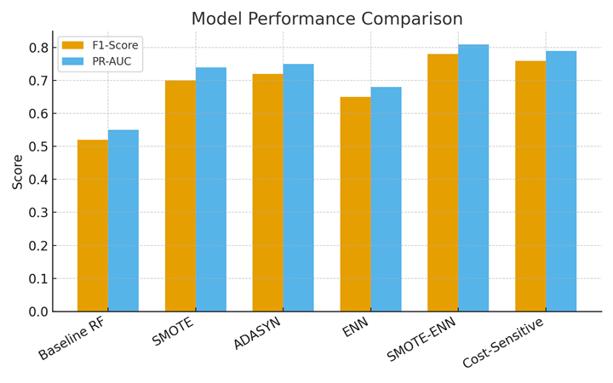
RESULTS
•Baseline Random Forest: High accuracy but poor recall (F1=0.52).
•Best Model: Random Forest + SMOTE-ENN (F1=0.78, PR-AUC=0.81).
•Key predictors: Age, Hypertension, BMI, Heart Disease, Smoking.
•SHAP provided patient-level explanations for clinical trust.
Our results show that a baseline Random Forest model had poor stroke detection (F1=0.52). Applying a hybrid SMOTE-ENN balancing technique significantly improved performance, achieving a superior F1-score of 0.78. Key predictors identified were Age, Hypertension, and BMI, and SHAP provided patient-level explanations for clinical trust.

Slide 9
MAIN CONTRIBUTIONS
Systematic imbalance handling
We proved that over-sampling with SMOTE is superior to other methods for detecting rare stroke cases.
Clinically actionable interpretability
This transforms the "black box" model into a transparent tool, explaining the specific risk factors for each patient.
Robust preprocessing pipeline
Our pipeline effectively handles real-world data challenges like missing values to ensure model reliability.

Slide 10

Conclusion
Robust and interpretable – The proposed framework improves predictive performance while ensuring trust.
Best model – Random Forest with SMOTE-ENN proved most effective in balancing accuracy and clinical relevance.
SHAP ensured transparency for clinicians.
Future direction – Validation on multi-center hospital data + multimodal inputs.

Slide 11
DO YOU HAVE ANY QUESTION ?

Slide 12

THANK YOU

